Slide 1



Computer Network
Class VI
lab 6

Slide 2
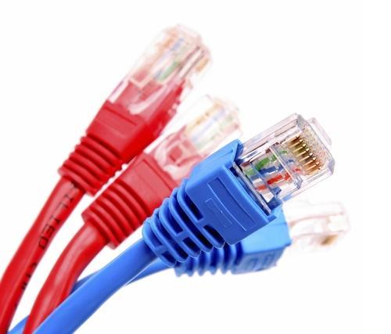
Networking Cables
Networking cables are networking hardware used to connect one network device to other network devices

Slide 3
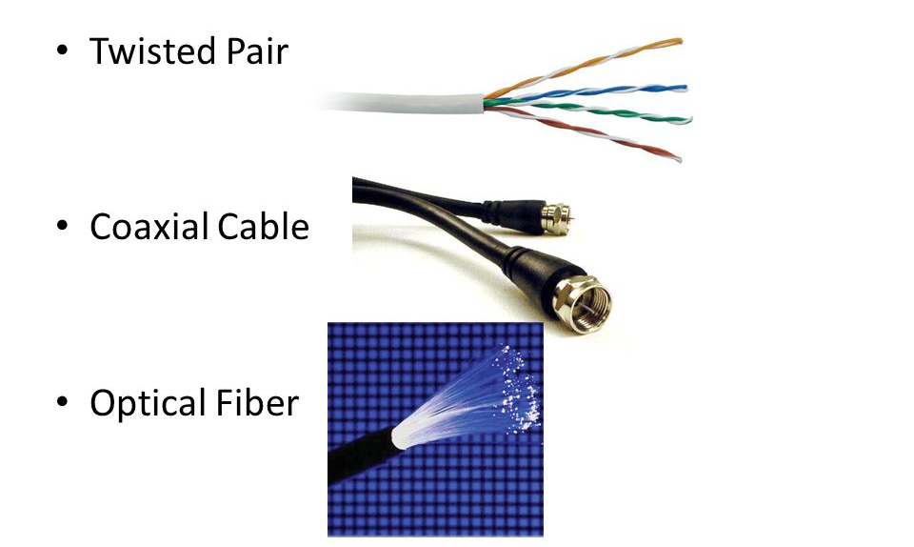
Types of Networking Cables
Twisted pared cable
Co-axial cable
Optical fiber

Slide 4
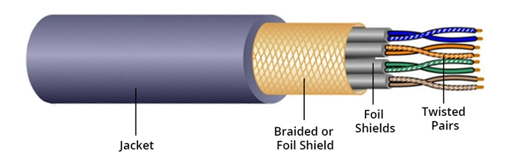
Twisted pared cable
Twisted pair cables are quite literally a pair of insulated wires that are twisted together to help reduce noise from outside sources

Slide 5
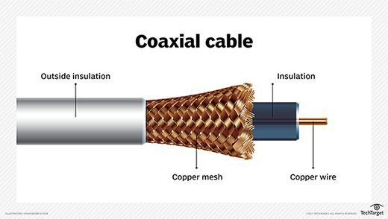
Coaxial cables
Coaxial cables are high-frequency transmission cables made up of a single solid-copper core.

Slide 6
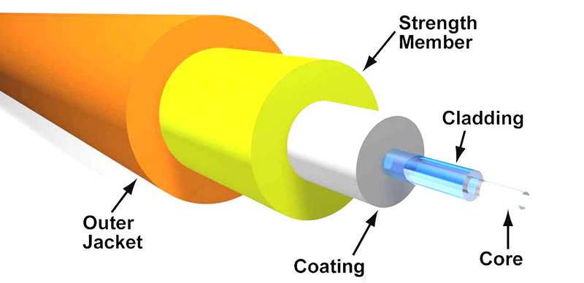
Fiber Optic Cables
Fiber optic cable transmits data as pulses of light go through tiny tubes of glass

Slide 7



